Slide 1
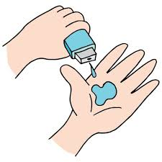
Project Title – Healthcare Analytics for Doctor Visits
Sai Krishna Rao Kaveliga
Joginpally BR Engineering College(JBREC)-HYD
Computer Science Engineering

Slide 2

PROBLEM STATEMENT
Develop a healthcare analytics system aimed at optimizing doctor visits by analyzing patient demographics, visit frequencies, common ailments, and peak times.
This system will help healthcare providers enhance scheduling efficiency, reduce waiting times, and improve patient outcomes.
By leveraging data analytics, the system will offer insights into patient patterns and behaviors, enabling better resource allocation and service design.
The ultimate goal is to create a more efficient healthcare delivery process, ensuring timely and effective care for patients while maximizing the utilization of healthcare resources and improving overall patient satisfaction and experience.

Slide 3
Project Description
The Healthcare Analytics for Optimizing Doctor Visits project aims to create an advanced system that leverages data analytics to improve the efficiency of doctor appointments. By examining patient demographics, visit frequencies, common ailments, and peak times, the system provides actionable insights for healthcare providers. These insights enable better scheduling, reduce waiting times, and enhance patient outcomes. The project focuses on optimizing resource allocation, ensuring effective use of medical staff and facilities, and improving patient satisfaction by minimizing delays and delivering timely care, ultimately enhancing the overall healthcare delivery process.

Slide 4

WHO ARE THE END USERS?
Doctors: Utilize insights for better scheduling and patient management.
Nurses: Coordinate care and manage patient flow more effectively.
Administrative Staff: Streamline appointment booking and reduce wait times.
Patients: Experience shorter wait times and more personalized care.
Hospital and Clinic Managers: Optimize resource allocation and improve operational efficiency.
Healthcare Data Analysts: Analyze data to provide actionable insights and improve healthcare delivery.
Insurance Companies: Use data for better risk assessment and to improve the claims process.

Slide 5

Technology Used
Integrated Development Environment (IDE):
Visual Studio Code (VS Code)
Version Control and Collaboration:
GitHub for repository management and version control
Data Analysis and Manipulation:
Python for data cleaning, preprocessing, and analysis
Numpy for numerical computing and array operations
Pandas for data manipulation and analysis
Data Visualization:
Matplotlib and Seaborn for visualizing data within VS Code
Presentation Creation:
Microsoft PowerPoint for preparing project presentations

Slide 6
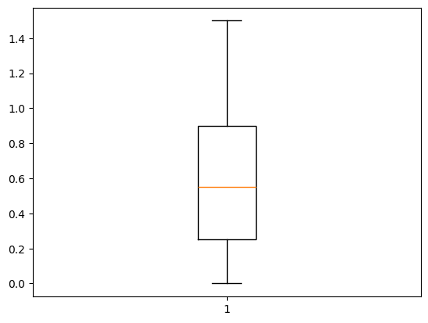
RESULTS
ProjectLink

Slide 7
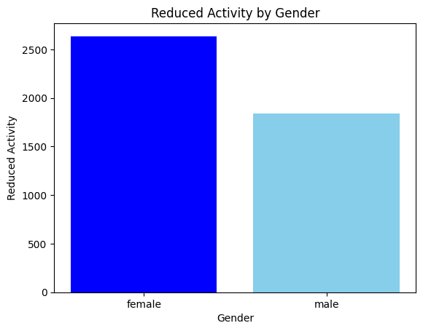
RESULTS
ProjectLink

Slide 8
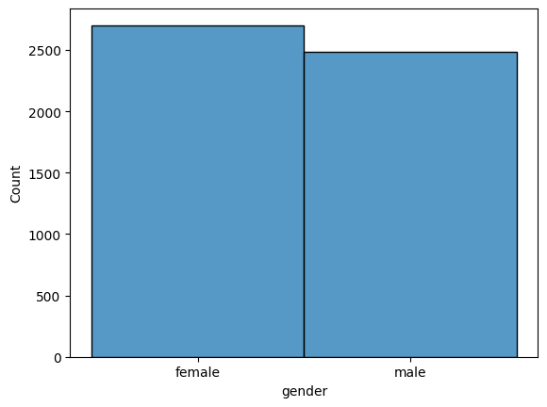
RESULTS
ProjectLink

Slide 9
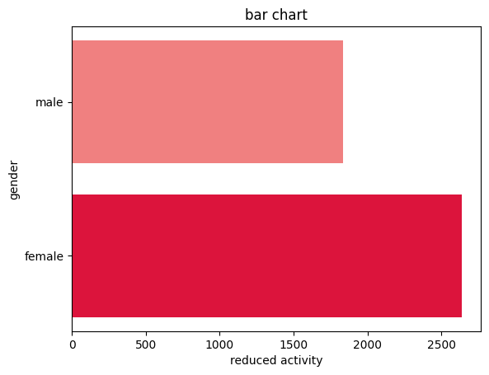
RESULTS
ProjectLink

Slide 10
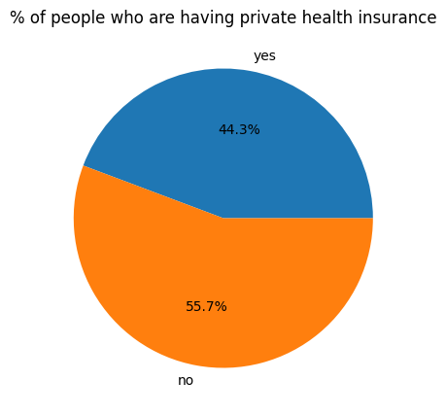
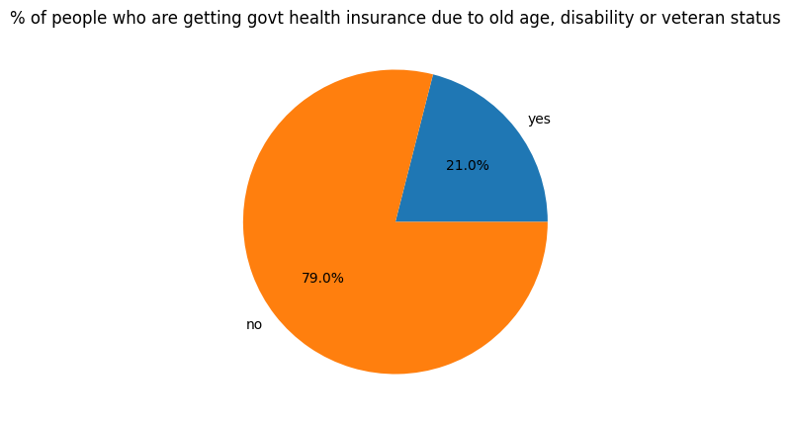
RESULTS
ProjectLink

Slide 11
Thank You
.
.

